Slide 1
S3 EVENT NOTIFICATIONS IN AWS
OBJECTIVE:
Currently, Amazon S3 can publish notifications for the following events:
•New object created events
• Object removal events
• Restore object events
• Reduced Redundancy Storage (RRS) object lost events
• Replication events
Amazon S3 can send event notification messages to the following destinations. You specify the Amazon Resource Name (ARN) value of these destinations in the notification configuration.
• Amazon Simple Notification Service (Amazon SNS) topics
• Amazon Simple Queue Service (Amazon SQS) queues
• AWS Lambda function
• Amazon Event Bridge

Slide 2
LIST OF SERVICES INTEGRATED
Service | Role
Amazon S3 | Stores files and triggers events
AWS Lambda | Processes files automatically
Amazon SNS / SQS (Optional) | Used for decoupling and fan-out messaging
Amazon DynamoDB / RDS | Stores processed output
CloudWatch | Monitors logs and metrics

Slide 3
SCOPE AND USE CASES OF SERVICES INTEGRATED
2
SCOPE:
Amazon S3 Event Notifications enable automated, event-driven processing of S3 objects when specific operations occur. These notifications can be sent to:
AWS Lambda
Amazon Simple Queue Service (SQS)
Amazon Simple Notification Service (SNS)

Slide 4
USE CASES:
Automatic File Processing
Description: Trigger a Lambda function when a new file (e.g., CSV, JSON, image) is uploaded to a bucket.
Example:
Extract data from CSV and write to DynamoDB
Generate thumbnails from uploaded images
Convert audio/video formats using AWS MediaConvert
Data Lake Ingestion Pipelines
Description: Automate ingestion into AWS analytics services.
Example:
Trigger a Lambda to load new JSON files into Amazon Redshift, Athena, or Glue
Use Step Functions to orchestrate ETL after object upload

Slide 5
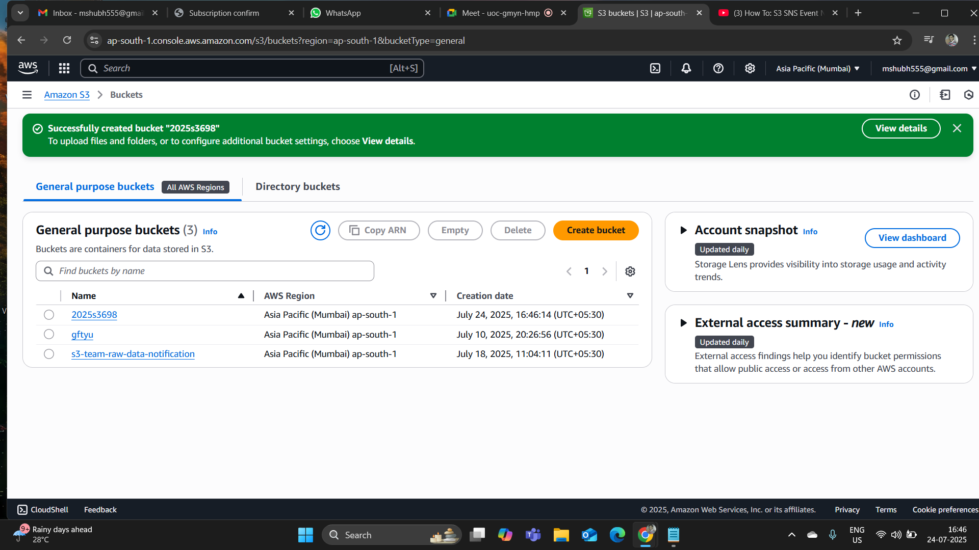
SCREENSHOTS AND OUTPUTS OF PRACTICAL WORK DONE

Slide 6
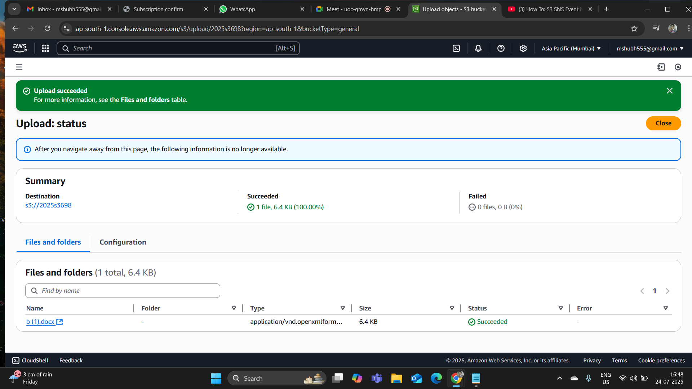

Slide 7
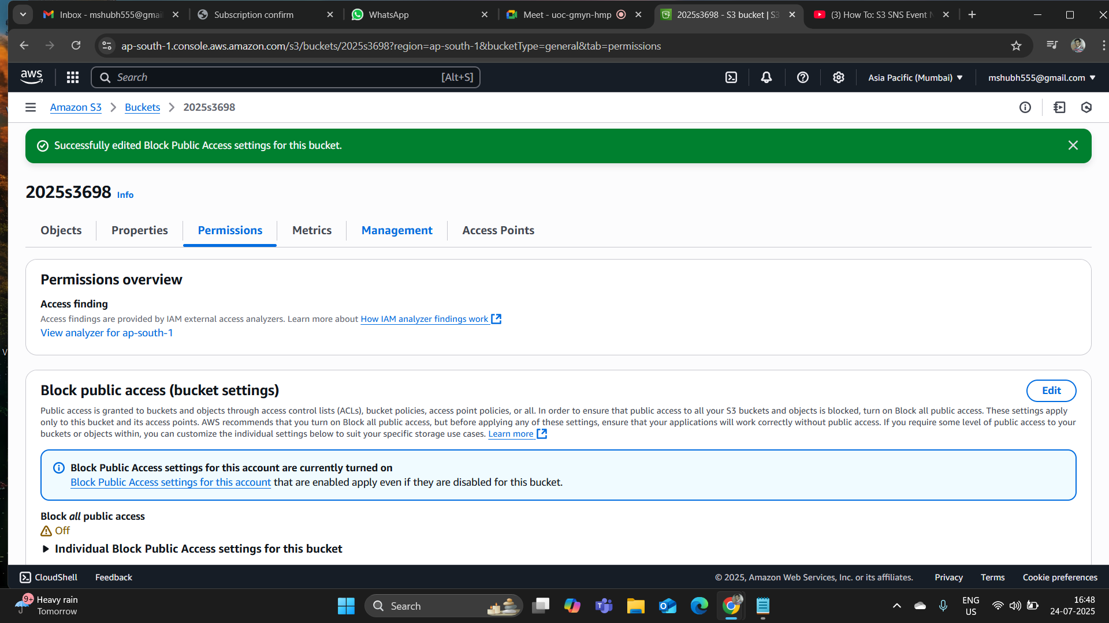

Slide 8
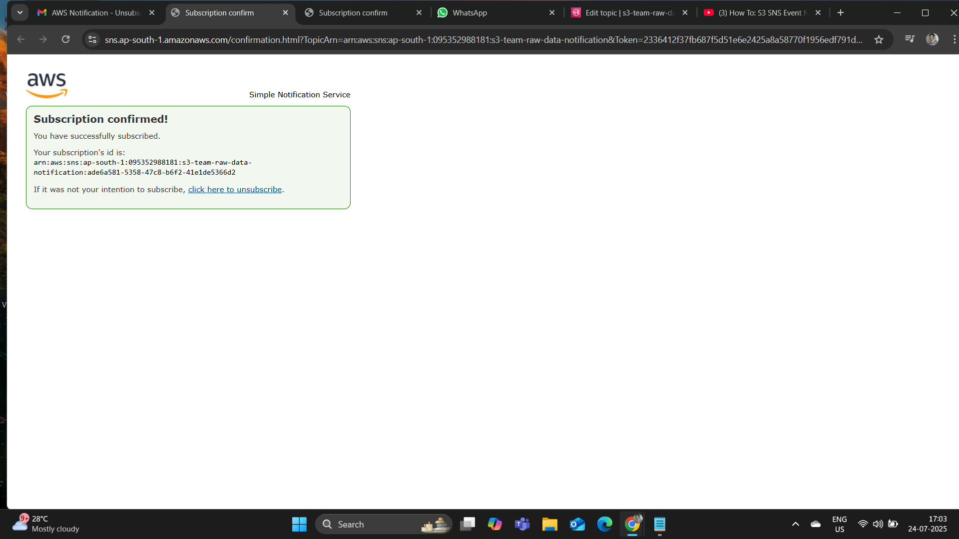

Slide 9
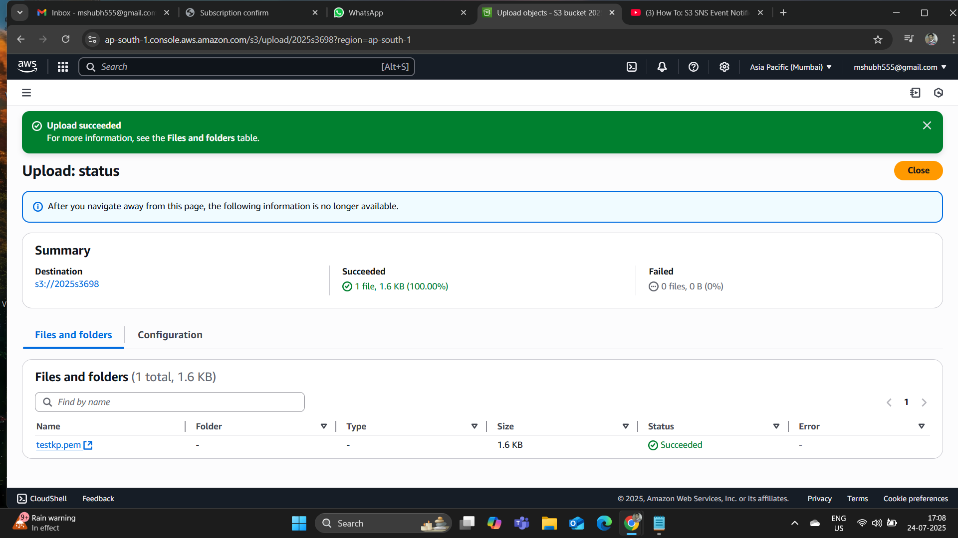

Slide 10
THANK YOU

